Slide 1
SOFTWARE CONFIGURATION MANAGEMENT

Slide 2
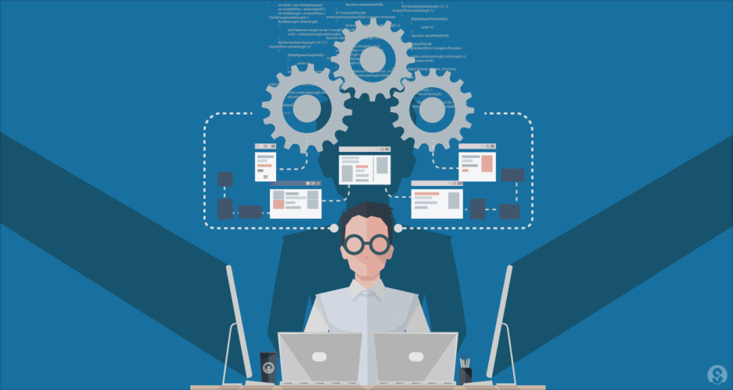
Branch, Version, Build and Install Management

Slide 3
Configuration Management Activities (Recap)
Configuration item identification
Configuration Management Directories
Baselining
Branch management
Version Management
Build Management
Install Management
Change Management
Promotion management
Release management
Defect Management

Slide 4
4. Branch Management
A codeline is a progression of the set of source files, and other artifacts, which make up software components as they change over time
A branch is a copy or clone of all, or at least a portion of the source code (or a code line) within the repository.
Code branching is done to reasons like
supporting concurrent development
capturing of solution configurations
supporting multiple versions of a solution
to enable developers to experiment in isolation enabling working without impact to others in parallel.
Branching helps in his keeping the overall product stable in situations as above.
Merging is bringing back and integrating the changes done in branches so all users of the branch can see.
Frequent merging from the related branched code lines into the working branch helps decreasing the likelihood and complexity of a merge conflict

Slide 5
4. Branch Management
There can be many branching strategies available which may be applied in combination.
Single branch (trunk based)
Branch by customer/organization
Branch by developer/workspace
Branch by module/component
…..
Branching management entails having a well defined branching policy, having an owner for the code lines and use branches for release

Slide 6
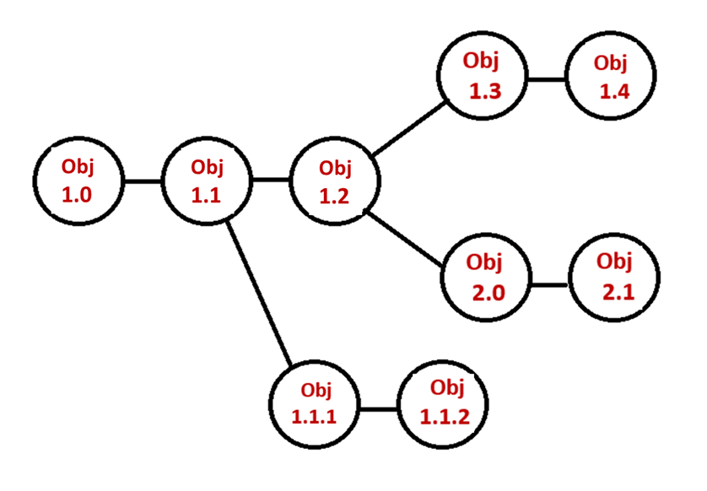
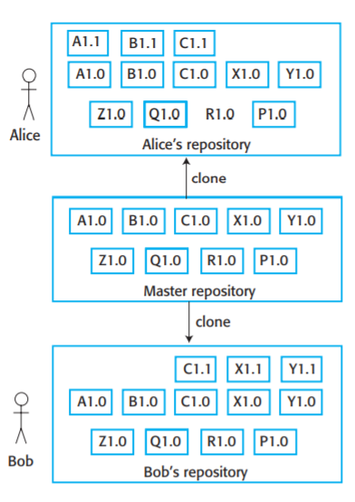
4. Branch and Version Management
The following examples showcases some of branching and the process of keeping track of different versions of software components and the systems in which these components are used

Slide 7
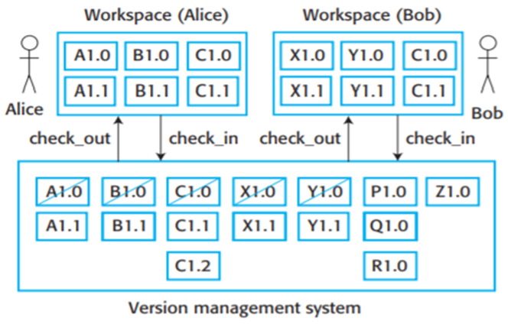
5. Version Management
Version management is the process of keeping track of different versions of software components and the systems in which these components are used. Typically tools like Git are used for version management of source code
Changes to a version are usually identified by a number, termed the "revision number"

Slide 8
5. Key Features of Version control System
All changes are attributable or traceable
Change history is recorded so every thing can be tracked and reverting back if needed is easier
Better conflict resolution
Easier code maintenance and code quality monitoring
Less software regression
Better organization and a better communication

Slide 9
6. Build Management - 1
Build management is actually a process of creating the application program for a software release by taking all the relevant source code files and libraries and compiling and linking them to create build artefacts, such as binaries or executable program etc.
This could involve collecting all the components making up an product component which can be released and performing all the tasks of compile, link and sanity test the binary.
Build is typically done using tools like the basic Make, Apache Ant, MS Build, Maven etc. which help in building software components

Slide 10
6. Build Management - 2
The process of build involves compilation of the various files, in the correct order and linking all the libraries in the appropriate order.
If the source code in a particular file has not changed then it may not need to be recompiled (may not rather than need not because it may itself depend on other files that have changed).
Sophisticated build utilities and linkers attempt to refrain from recompiling code that does not need it, to shorten the time required to complete the build.
Build automation involves scripting the process

Slide 11
6. Build Management - 3
Build Process
This consists of
Fetching the code from the source control repository
Compiling the code and checking the dependencies/modules
Linking the libraries, code, files, etc. accordingly.
Running the automated/manual unit tests
Once successfully passed, Build the artefacts and store them.
Archive the build logs.
Send the notification emails.
Typically this may lead to a version number change

Slide 12
6. Build Management - 4
Types of Builds:
Full Build
Incremental Build – Optimized Build
3. Build Triggers:
Manual Build Trigger
Scheduled Build Trigger
Source code repository Build Trigger
Post Process Build Trigger

Slide 13
7. Install Management - 1
Software installation is the first interaction developers have with their new user.
Its impactful in terms of being the brief period of opportunity and if the installation fails, it is likely that your user, short of attention-span and patience, will set a negative perception
This process could involve placing multiple files containing executable code, downloading or copying from a repository or drives more detailed executable files, images, libraries, configuration files developed by different developers, from the internet.

Slide 14
7. Install Management - 2
Software installation can also involve interaction with OS functions for validating the resources needed, permissions, versions, identifiers to ensure enforcement of licences and registration.
This may also involve customizations for localizations
Given that Installation involves complex detailed steps, this leads to the need automation and usage of tools like Zip/tar/Shell Scripts in a trivial state to InstallAware, InstallShield, Jenkins, Vagrant

